Slide 2
Multimedia – Labo 6
department of telecommunications and information processing
research group Image processing and interpretation
Gianni Allebosch, Martin Dimitrievski
{gianni.allebosch, martin.dimitrievski}éugent.be
Master of Science in de industriële wetenschappen: elektronica-ICT
Campus Ardoyen
BE - 9000 Gent

Slide 3
Tips & tricks
Keep youtr program user friendly!
Provide a README.txt
Execute each exercise sequentially in 1 script
Make clear which exercise is currently being executed
Name your windows when showing images
If input is required from the user, make sure the instructions are clear

Slide 4
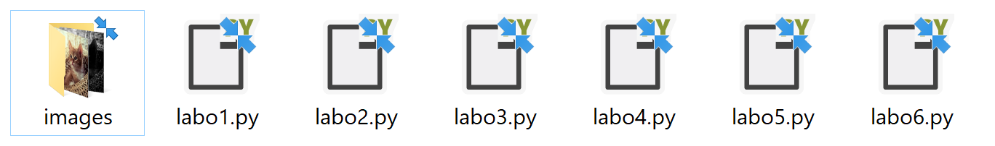
Tips & tricks
Be sure the code is executable as is!
We will not change your code!
Functions in comments will not be executed
Store all input images in a folder named “images” next to your code
Do not use absolute paths but use relative paths (portability!):
✗ “C:/users/admin/multimedia/labo1/images/lena_color.jpg”
✔ “images/lena_color.jpg”

Slide 5
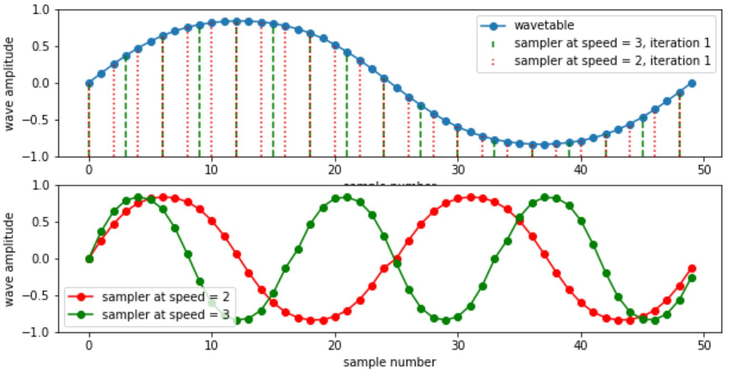
Wavetable synthesis
Wavetable = 1 cyclus of a random periodic wave
Wavetable synthesis = new wave is created by iterative sampling of the wavetable at certain sampling speed

Slide 6
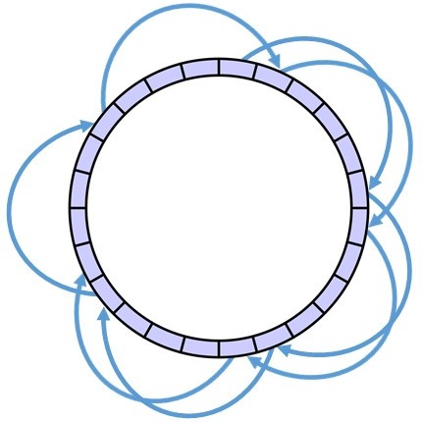
Wavetable synthesis
Wavetable = circular buffer
Wavetable synthesis = new wave is created by sampling of the wavetable with certain step size

Slide 7
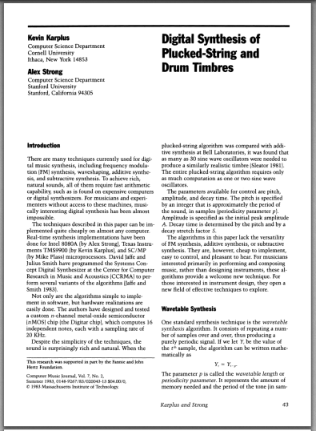
Karplus-Strong
Read also: labo6_karplus_strong.pdf

Slide 8
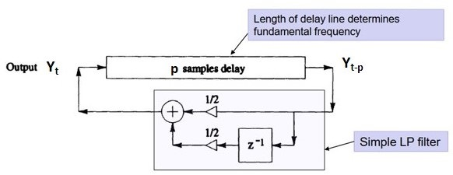
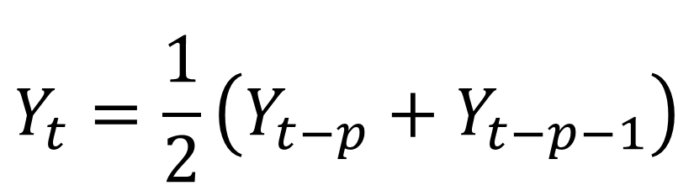
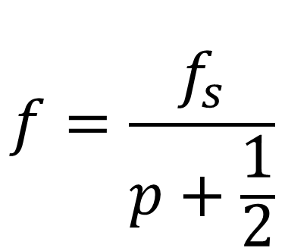
Karplus-Strong
Based on wavetable synthesis: wavetable changes during sampling
$$Y_{t}=\frac{1}{2}\left(Y_{t−p}+Y_{t−p−1}\right)$$
$$f=\frac{f_{s}}{p+\frac{1}{2}}$$

Slide 9
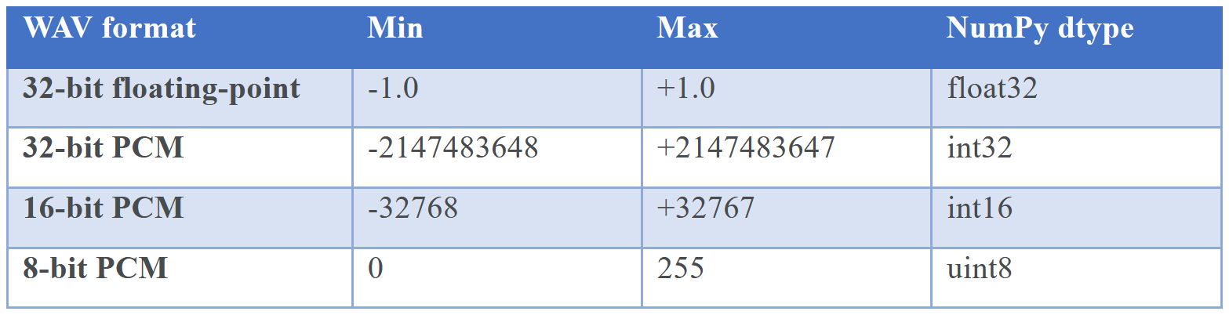
TIPS & TRICKS
Playing and Recording Sound in Python
Libraries:
playsound
simpleaudio
winsound
python-sounddevice
pydub
pyaudio
Source: SciPy.org

Slide 10
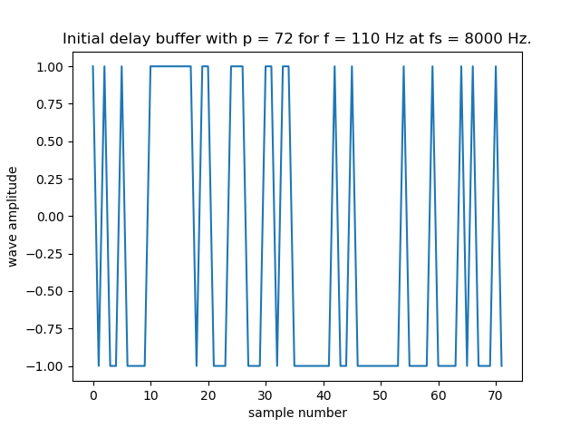
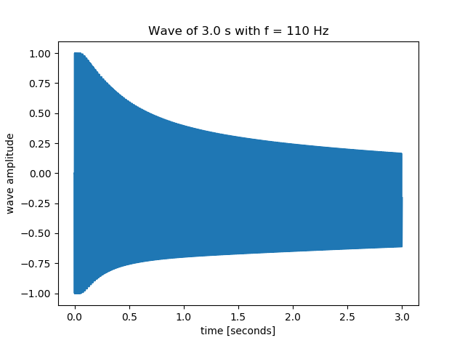

Exercise 1
*Download this PowerPoint presentation for audio

Slide 11
Question - Exercise 1
Solve the question in your README.txt
What is the consequence of the fact that p must be an integer?

Slide 12
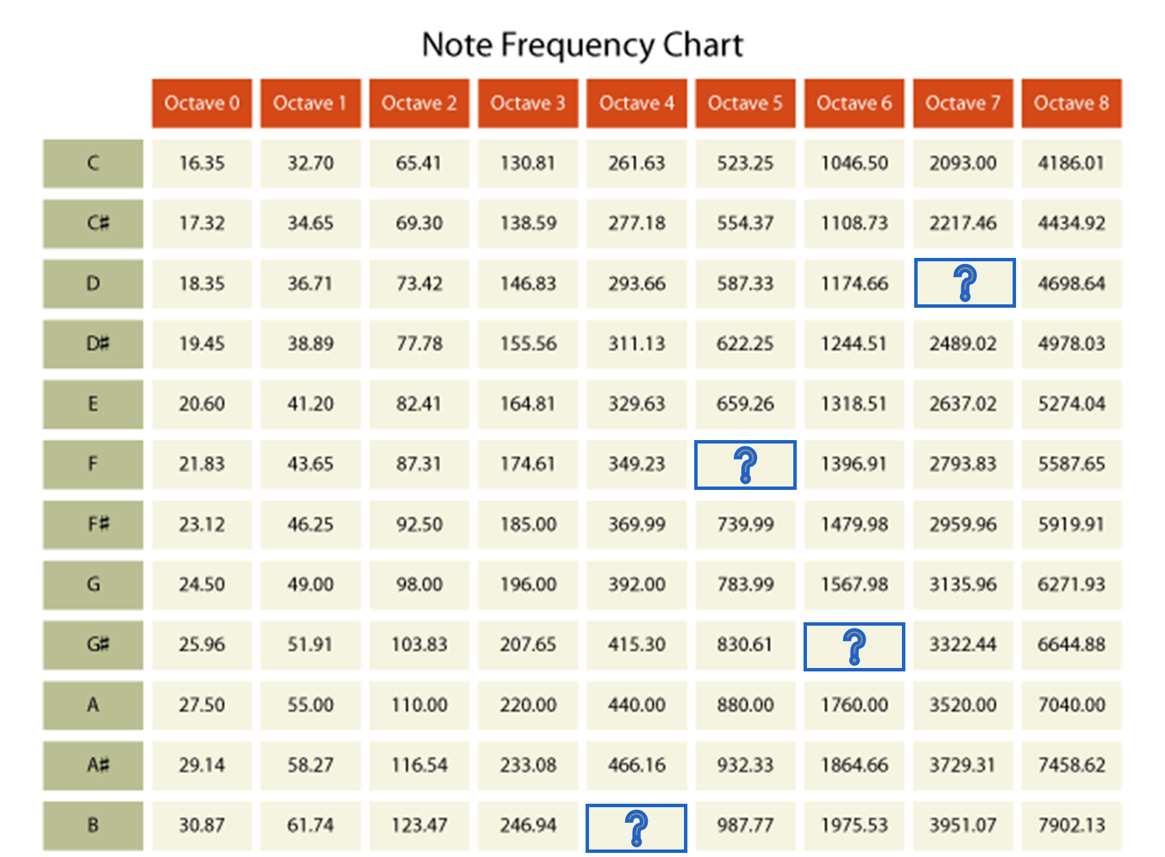
Exercise 2

Slide 13
Question - Exercise 2
Solve the question in your README.txt
What is the frequency of the notes B4, F5, G#6 and D7?

Slide 14
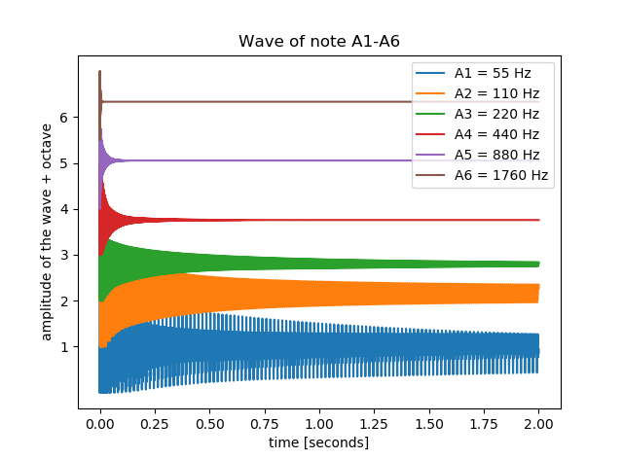
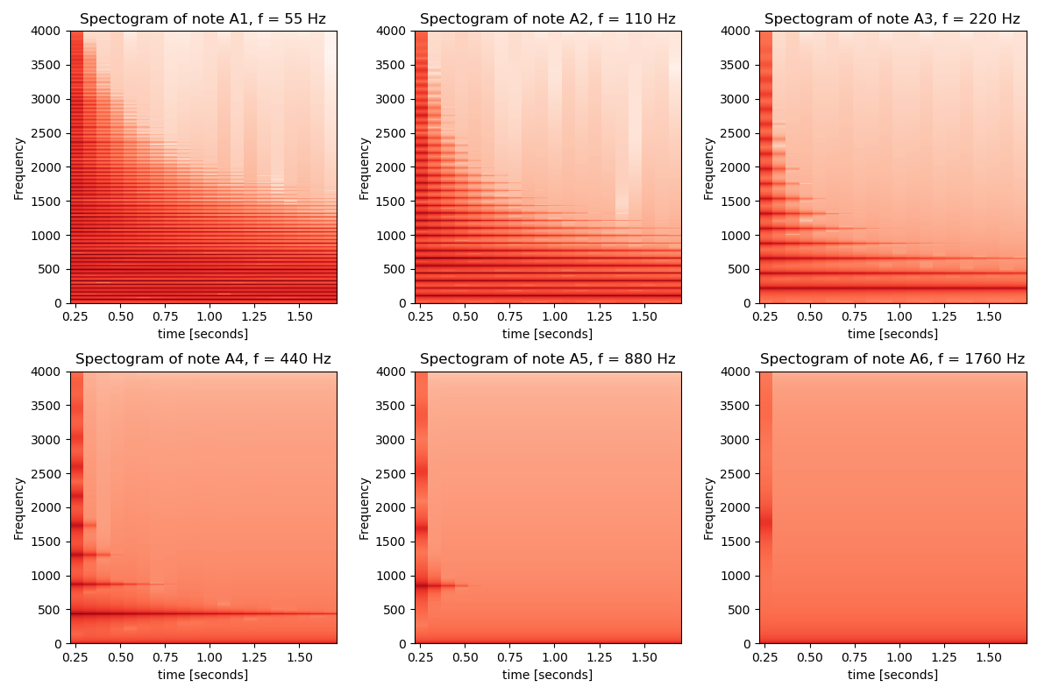
Exercise 3

Slide 15
Question - Exercise 3
Solve the question in your README.txt
What effect does the frequency have on the course of the sound wave? What else can you see on the frequency spectrum?

Slide 16

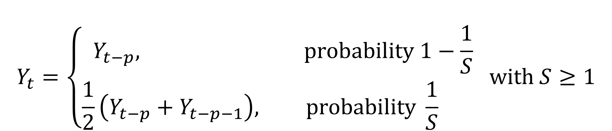
Stretching the decay
Making the note longer:
Decay:
$$Y_{t}=\left\{\begin{aligned}Y_{t−p}, \text{probability} 1−\frac{1}{S} \\ &\frac{1}{2}\left(Y_{t−p}+Y_{t−p−1}\right), \text{probability} \frac{1}{S} \end{aligned} \text{with} S≥1\right.$$
$$D≈\frac{2p^{3}}{π^{2}n^{2}f_{s}}\sim \frac{p^{3}}{n^{2}}$$

Slide 17
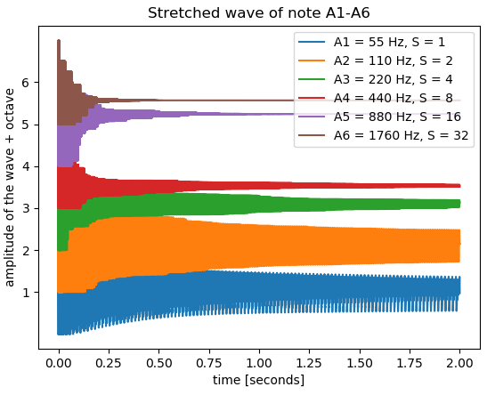
Exercise 4

Slide 18
Question - Exercise 4
Solve the question in your README.txt
What ratio does the stretching factor correspond to?

Slide 19
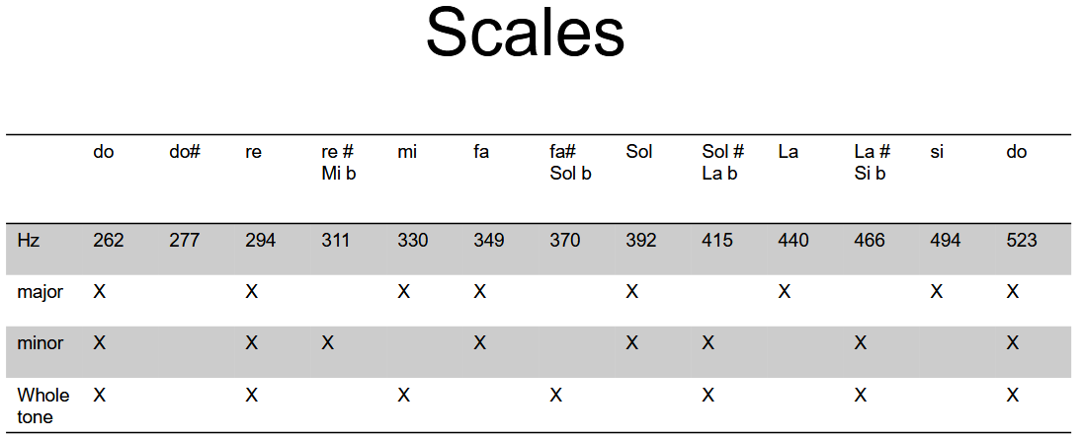
Exercise 5

Slide 20


Exercise 6

Slide 21
Tips & tricks
Deliver your working code before next session
Opdrachten on Ufora
1 python script named labo#.py
README.txt (see example)
output.zip with every output file

Slide 22
Tips & tricks
Questions or need help? Contact us at:
Gianni.Allebosch@UGent.be AND Martin.Dimitrievski@UGent.be

Slide 23
GOOD LUCK!

